Slide 1
From contact matrix to biology
Nezar Abdennur
Mirny Lab, MIT

Slide 2
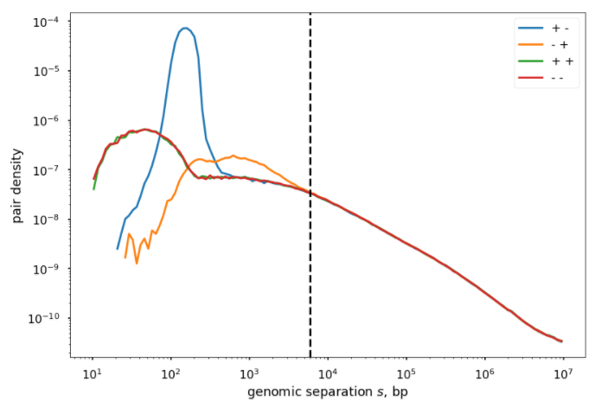
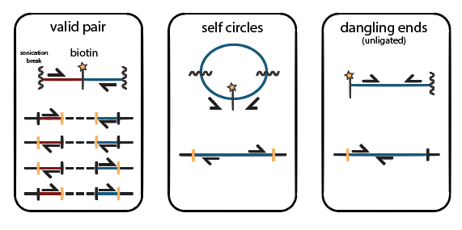
Genomic proximity and informative ligation products
Enriched in dangling ends
align
classify
Enriched in self circles
sort + dedup
filter + bin
balance

Slide 3
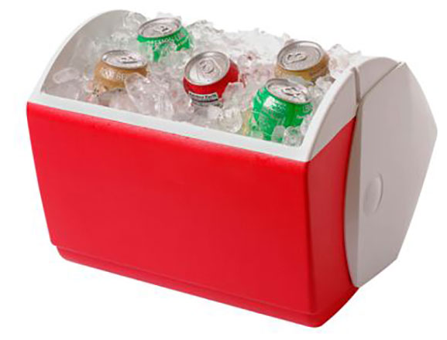
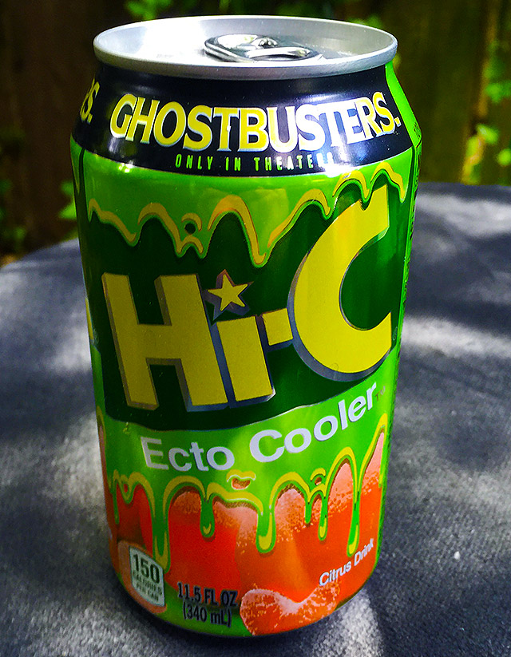
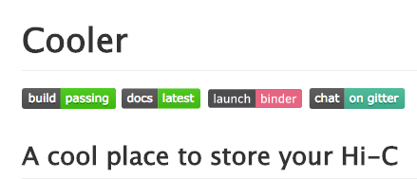
align
classify
sort + dedup
filter + bin
balance

Slide 4
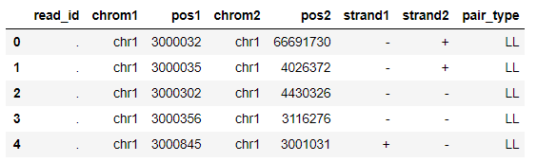
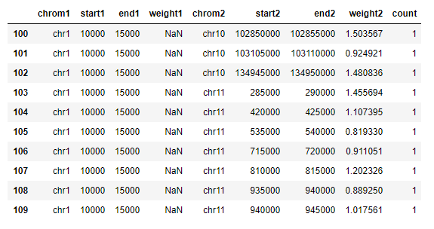
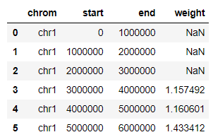
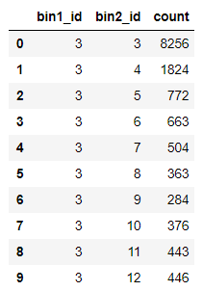
pairs
align
classify
aggregate
bins
(nonzero) pixels
sort + dedup
filter + bin
“join”
(annotate)
+
balance

Slide 5
Cooler
Sparse, binary, columnar, compressed storage schema based on HDF5 (.cool)
Python support library and CLI provides tools to create, aggregate, query, and normalize coolers
Provides sparse, parallel, out-of-core matrix balancing
Aims to integrate smoothly with the Python data ecosystem: numpy, pandas, dask, jupyter
align
classify
sort + dedup
filter + bin
balance

Slide 6
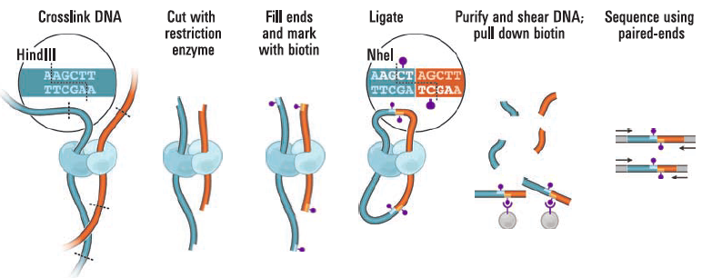
Bias correction (normalization)
Ligation efficiency as a
function of fragment length
Digestion efficiency as a
function of sequence composition
(and DNA compaction)
Sequencing efficiency as a
function of sequence composition
Can be applied to whole genome, cis maps, or other subsets
Explicit factor methods
Model bias due to GC content, fragment lengths, etc.
Matrix balancing (iterative correction)
Don’t model explicit sources of bias. Only assumes factorizable biases.

Slide 7
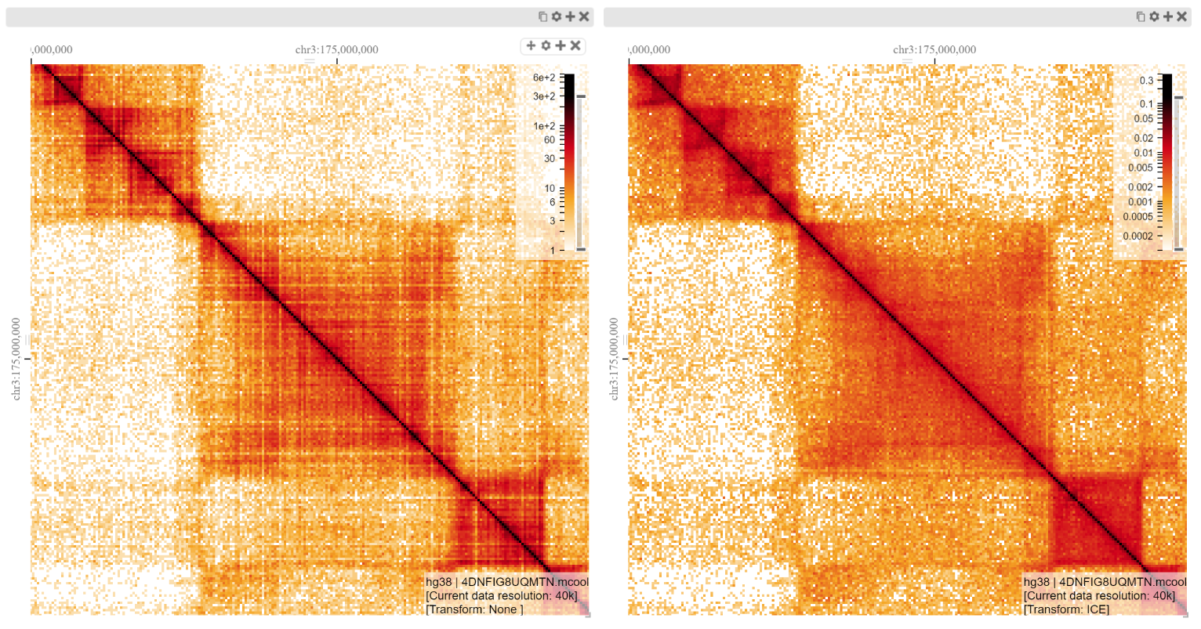
Bias correction: Matrix Balancing
http://bit.ly/2uHd98l
Uncorrected
Corrected (balanced)

Slide 8
Patterns vs interpretations
Contact decay profile with genomic distance
Diagonal squares that checker in cis and in trans
Diagonal squares that don’t checker
Peaks
Lines

Slide 9
Hi-C Features
Chr.1
Chr.X
P(s) curves: decay of contact freq with genomic dist in cis
Eigenvectors: checkering pattern in cis and trans
Insulation score: Loci that deplete contact freq between neighbors
“Pile-ups”: Aggregations of contact profiles centered at inferred features or at precise genomic landmarks
Chr.1
Chr.2
Chr.3
Chr.X

Slide 10
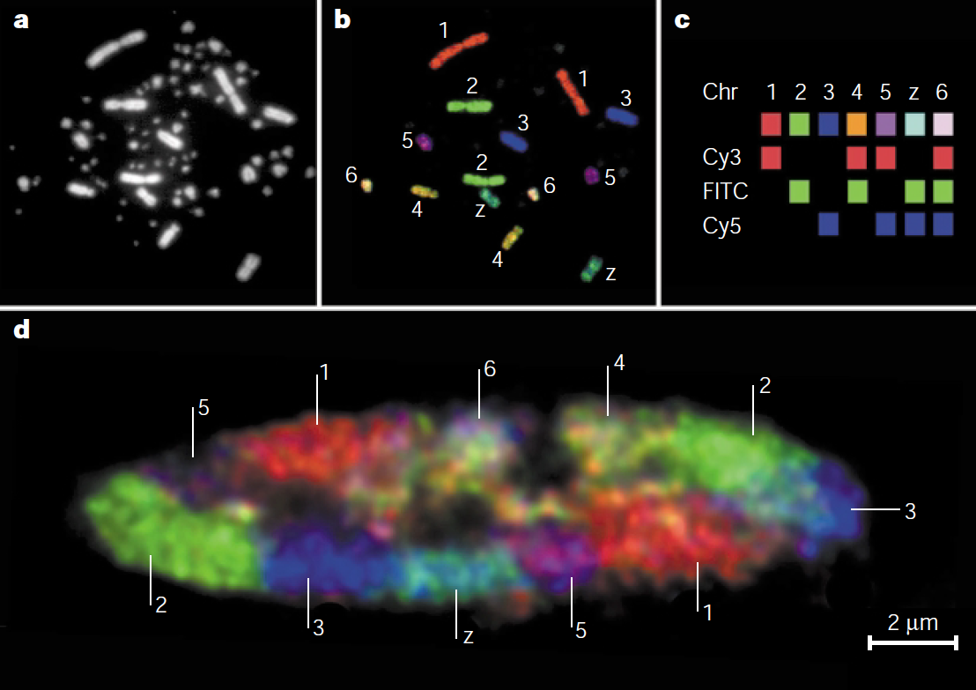
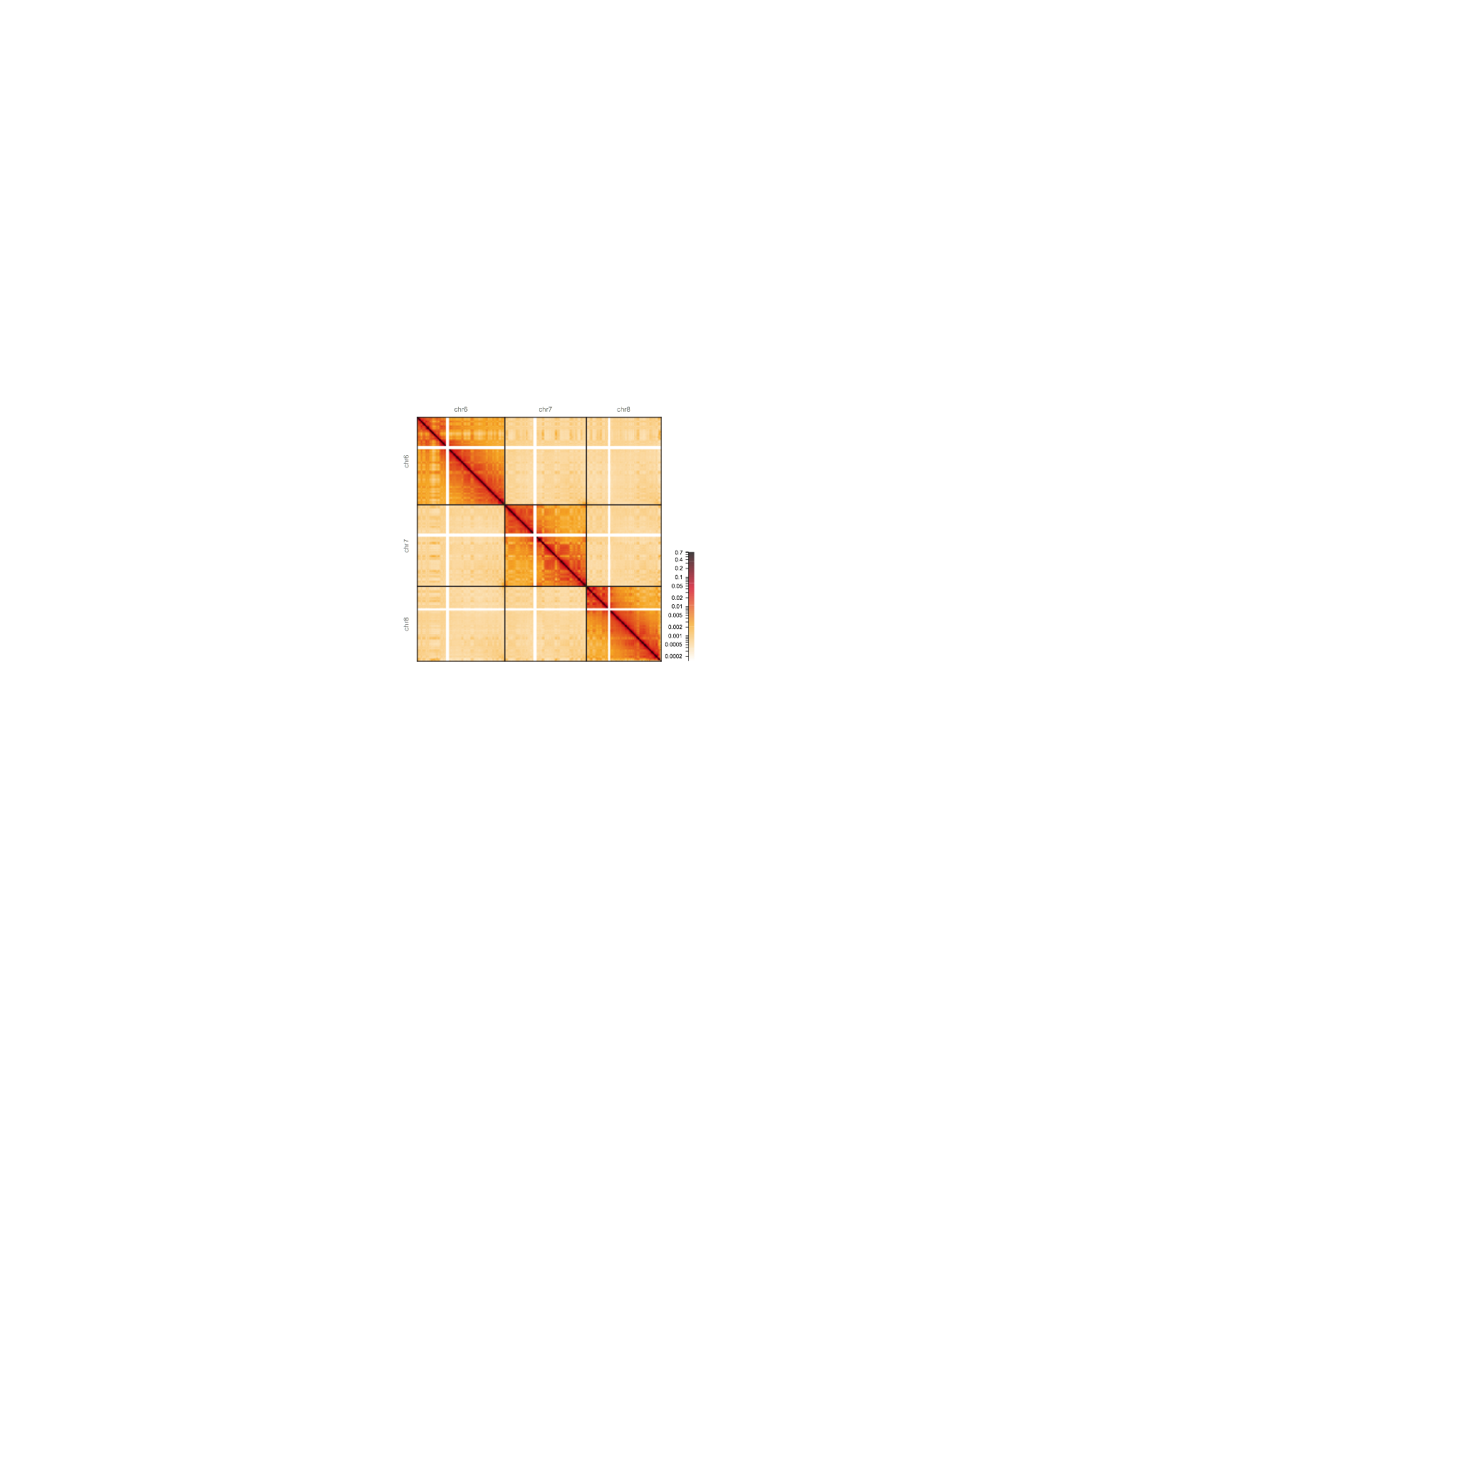
Territoriality
Chr.6
Chr.7
Chr.8
Chr.6
cis
trans
Chr.7
Chr.8
Cremer & Cremer, Nature Review Genetics (2001)

Slide 11
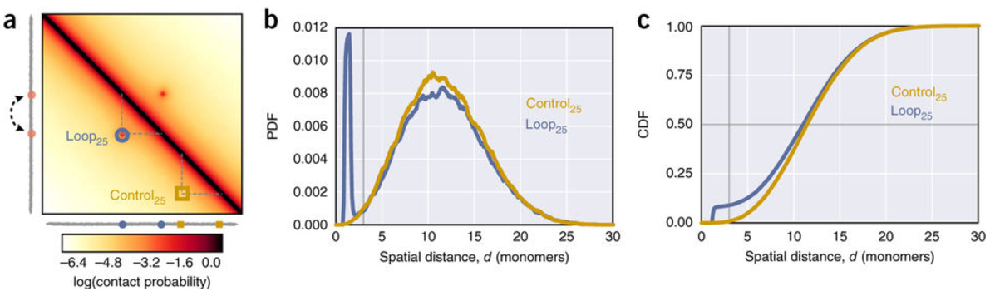
Caveat emptor
Contact probability != spatial distance
Contact enrichment does not imply regulatory function
TADs are not globules
TADs are not static loops
“Loops” are not static loops
Notes:
Any intrachromosomal proximity event could be considered a “loop”!

Slide 12
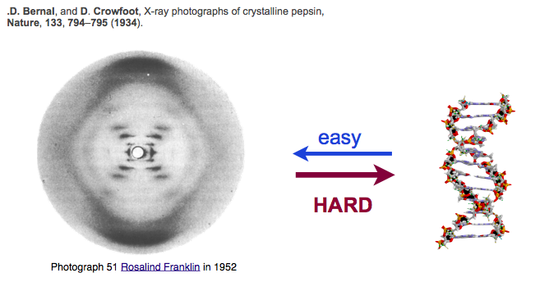
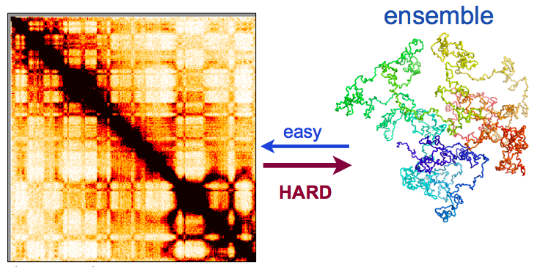
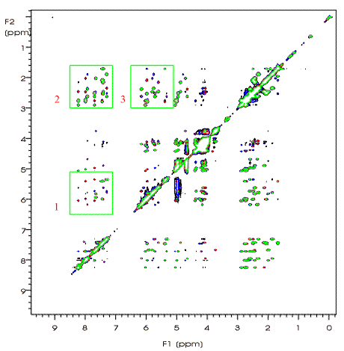
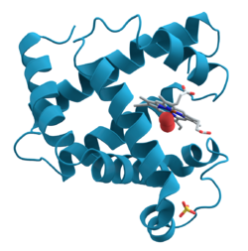
…chromosomes don’t form crystal structures
easy
…chromosomes don’t have a global “native fold”
hard
Protein contact map (NMR)

Slide 13
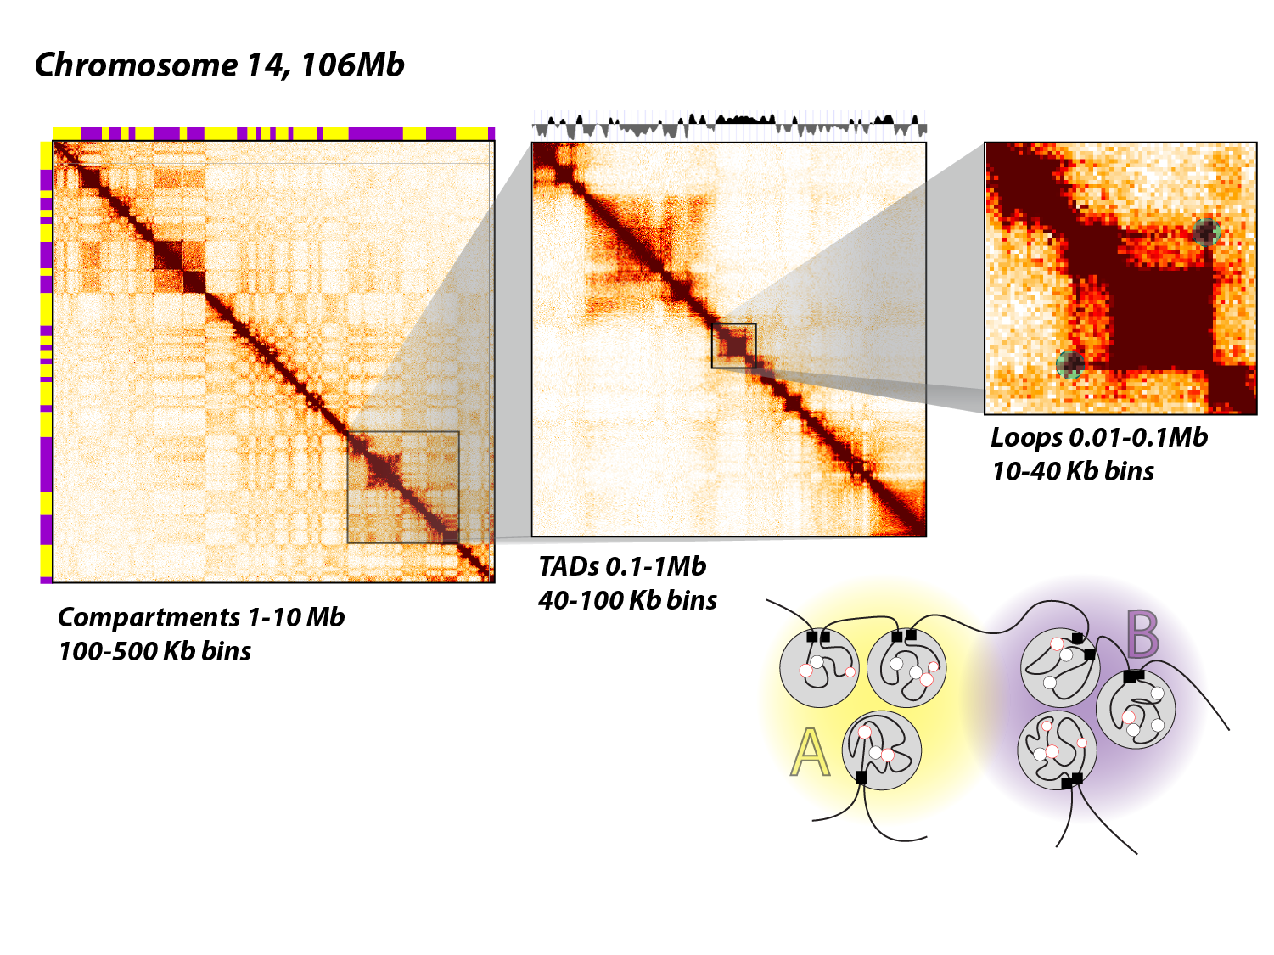
Scales of organization
cis
trans
Territories / chromosomes
Notes:
Scales/levels and processes

Slide 14
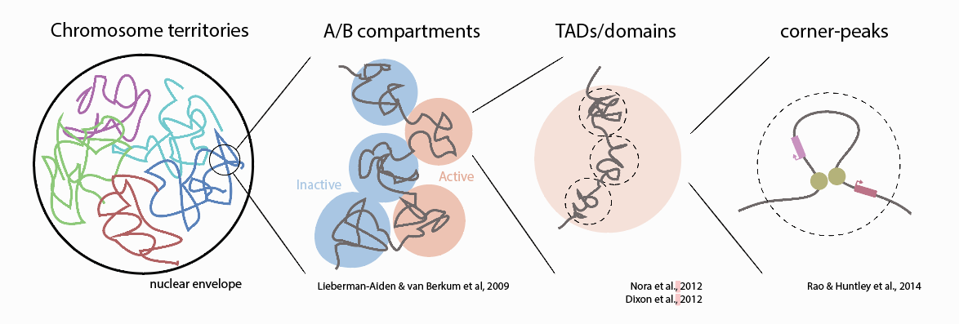
Interphase organizational hierarchy?

Slide 15
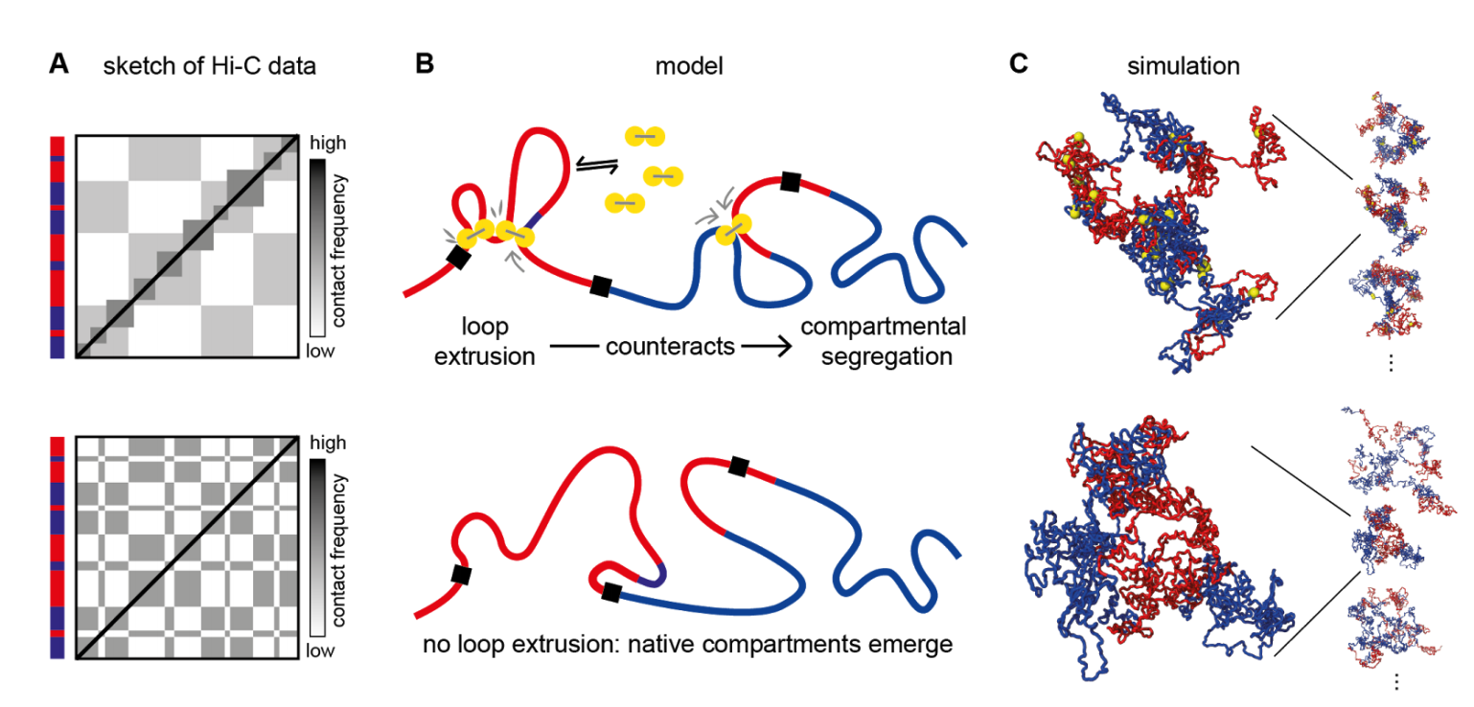
Organizational hierarchy processes
population average
ensemble
Nuebler et al, 2017 (bioRxiv)

Slide 16
P(s): Polymer nature of the chromatin fiber
input
feature
quantification
chr
chr
cis Hi-C maps
decay of intra-chrm contact frequency
P(s) with genomic distance, s
P(s) curves

Slide 17
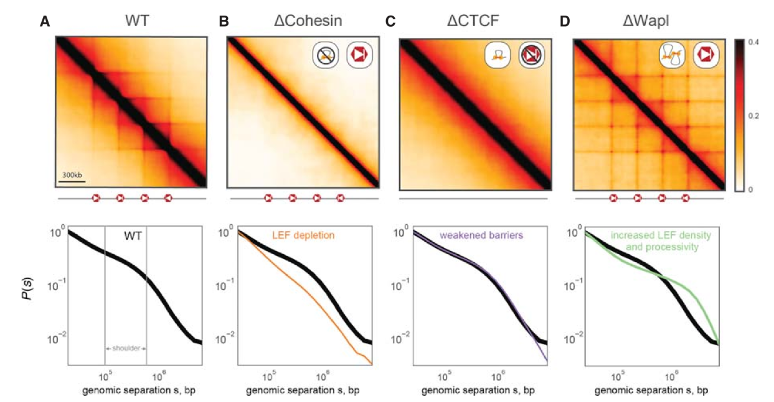
The head and shoulders of loop extrusion
Fudenberg, Abdennur et al, 2018

Slide 18
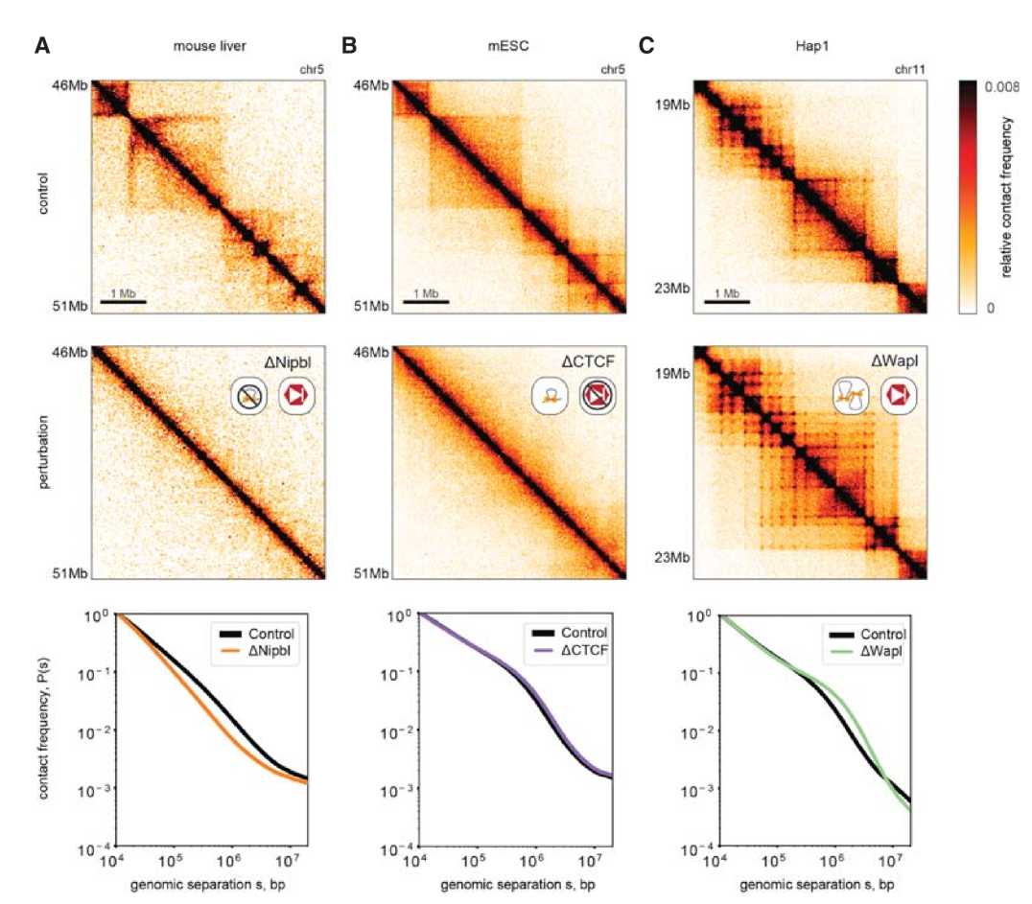
Schwarzer et al, 2017
Nora et al, 2017
Haarhuis et al, 2017
Fudenberg, Abdennur et al, 2018

Slide 19
Compartmentalization (segregation)
input
feature
quantification
chr
chr
cis and trans Hi-C maps
checkered pattern in cis and trans
A/B compartment eigenvector
*Other approaches: clustering

Slide 20
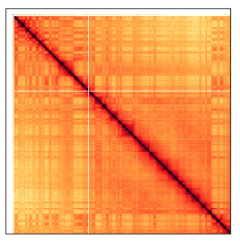
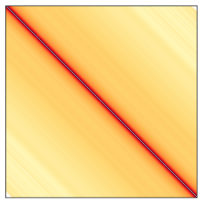
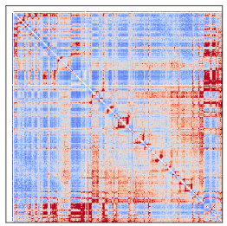
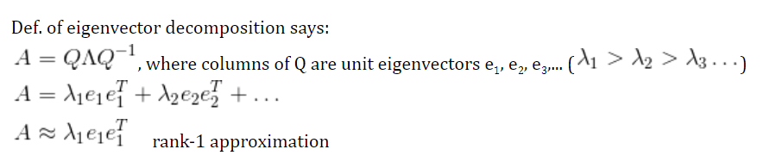
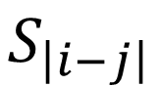
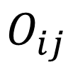
Eigendecomposition
$$O_{ij}$$
$$S_{\left|i−j\right|}$$
0-centered checkerboard
(
/
)
- 1
=
0

Slide 21
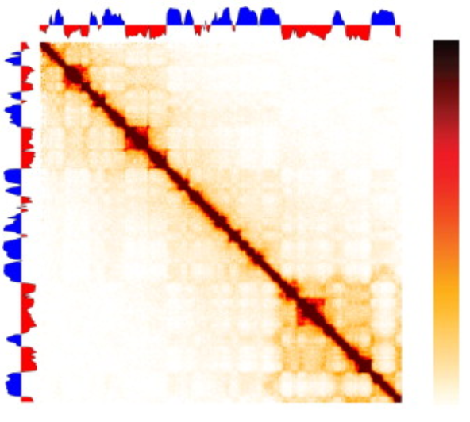
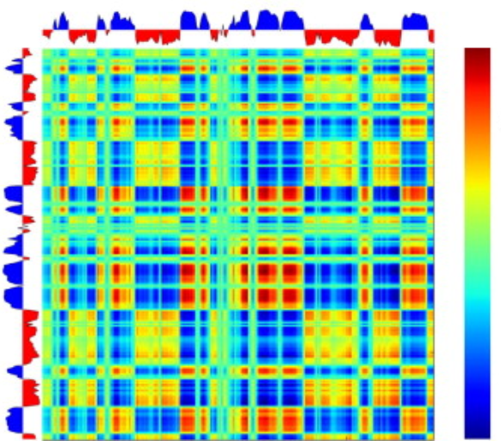
Eigendecomposition
Lajoie et al, 2015
E1 captures the checkerboard pattern!

Slide 22
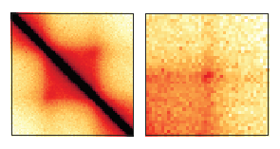
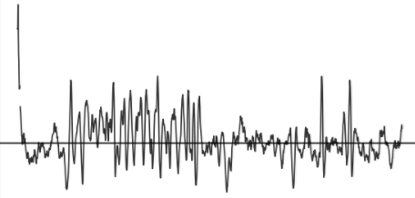
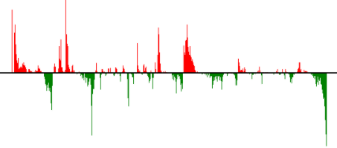
Local features
input
feature
quantification
cis, short distance (< few Mb)
Squares and peaks of contact enrichment
Various detection algorithms
Metrics of insulation, directionality, etc.

Slide 23
1-D score tracks
Insulation score
Directionality Index

Slide 24
http://bit.ly/2hdhkAn

Slide 25
The mighty pileup

Slide 28
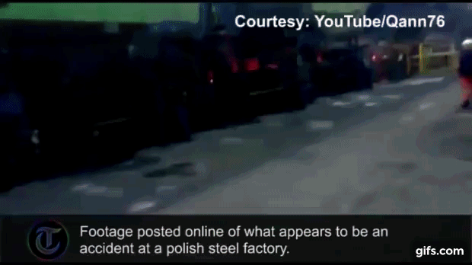
The loop extrusion model of TAD formation

Slide 29
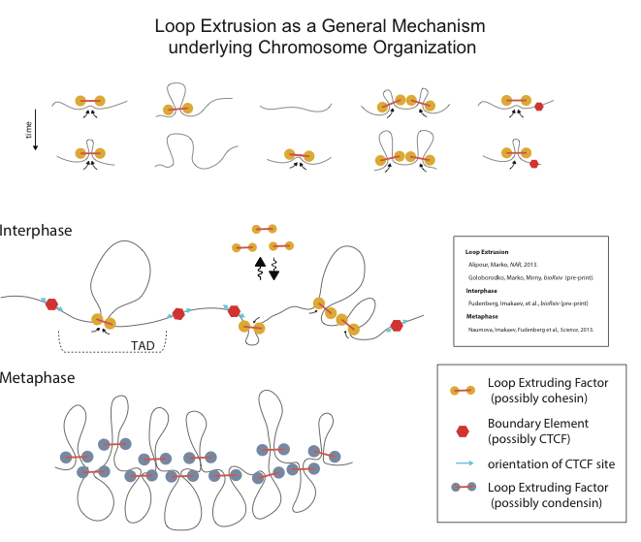
Riggs, 1990
Kimura, 1999
Nasmyth, 2001
Fudenberg et al. 2016
Sanborn et al. 2015
Alipour and Marko 2012
Goloborodko et al. 2016

Slide 30
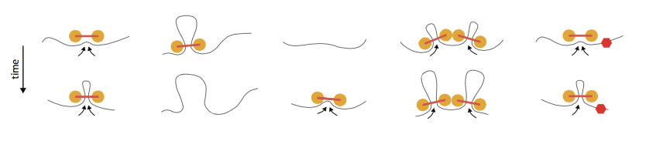
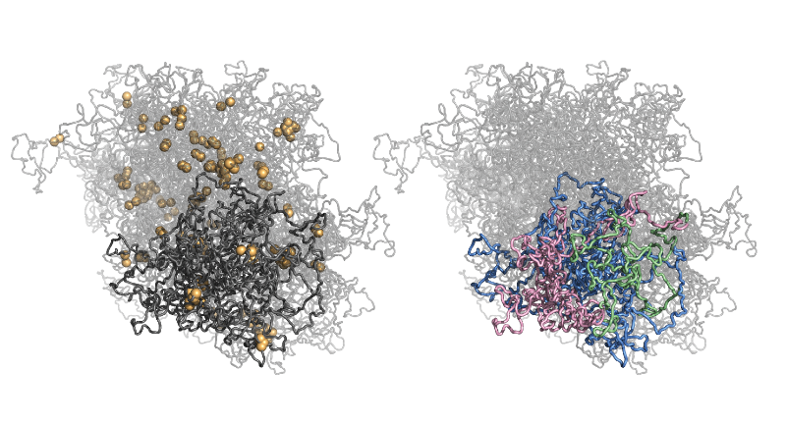
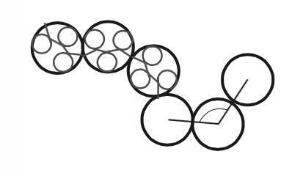
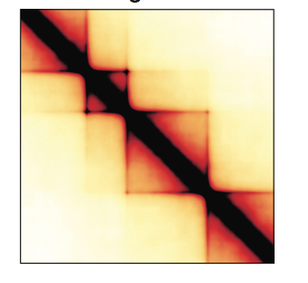
1D extrusion model coupled to 3D polymer simulations
Update rules for 1D model
Polymer model
Ensemble of conformations
In-silico Hi-C
Polymer simulations in OpenMM, see: Eastman, 2013; Eastman, 2016
For review see Imakaev, GF, Mirny, 2015
Notes:
The idea is:
-- what if a certain protein complex can land on the DNA, processively track along it?
-- solves the problem of segregating sister chromatids
This was actually a follow-up on her work from the previous year, where she investigated other polymer models of TADs, and found that they were actually unsuccessful at reproducing Hi-C data. I can briefly touch on this during the question session or offline, but the important take home was that it is difficult to insulate 3D contacts with barriers, or boundary elements, that are small relative to the size of the TAD (its important to make models high-enough resolution to see this. Not too coarse grained).

Slide 31
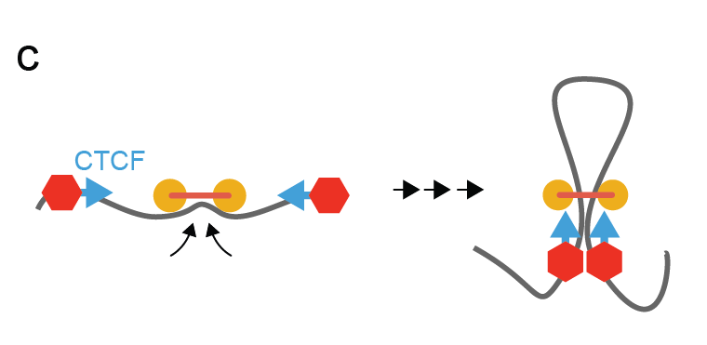
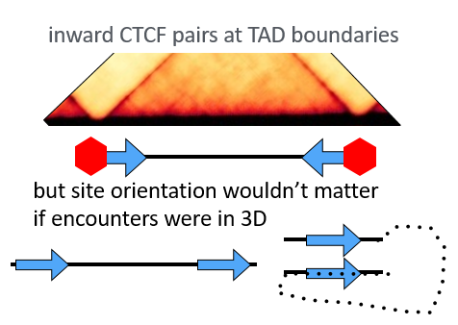
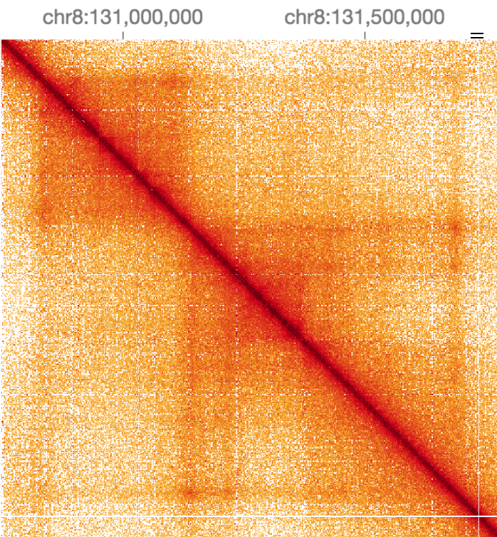
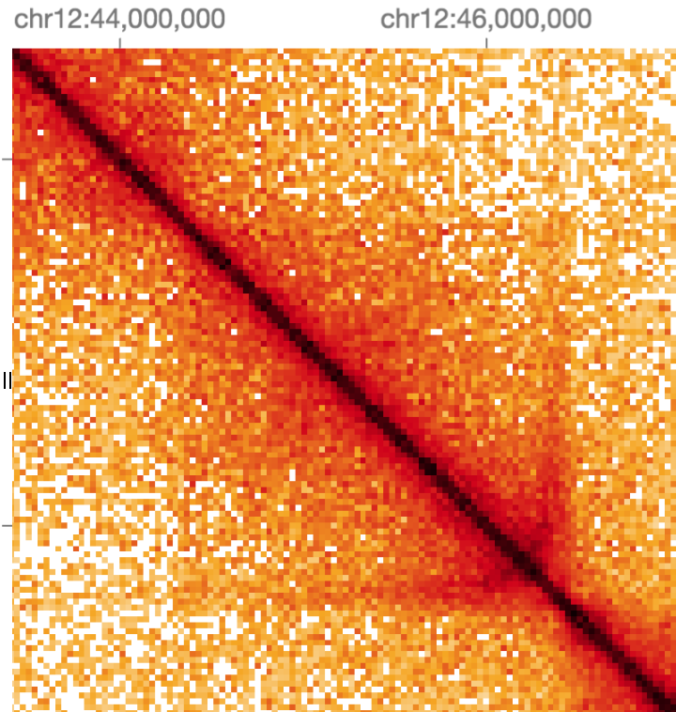
TAD model checklist
Loop extrusion can
orient over long distances
Enriched interactions throughout TAD | ✔
Does not form alternating compartments | ✔
Boundary deletion → spreading | ✔
Peaks only between proximal boundaries | ✔
Explain inward CTCF at boundaries | ✔
Accumulation LEFs inside of bound CTCFs | ✔
Not simple stable loops | ✔
Rao et al., 2014
Sofueva & Yaffe et al., 2015
Flames (aka lines) are a pervasive feature of
Hi-C maps, consistent with loop extrusion
Human GM12878 from
Rao & Huntley, 2014
Mouse liver from
Schwarzer et al., 2016

Slide 32
How to process Hi-C data
align
bwa mem
Pipeline
bwa – map paired-end reads
pairsamtools – parse mapping output, classify and filter pairs
cooler – aggregate pairs into contact matrices and normalize
Distiller:
nextflow-based scalable and reproducible implementation
classify
pairsamtools
sort + dedup
pairsamtools
filter + bin
cooler
balance
cooler

Slide 33
align
Align paired end reads to the reference assembly
Historically, this was done using iterative global alignment
Today, the more common approach is to use an efficient local alignment algorithm (e.g., bwa-mem)
classify
sort + dedup
filter + bin
More efficient
More sensitive
Ambiguous chimeric alignments can be further processed to detect multi-point ligation events (a.k.a. C-walks)
balance

Slide 34
align
form Hi-C pairs by reporting the outer-most mapped positions and the strand on the either side of each molecule
find and rescue chimeric alignments produced by Hi-C molecules having a sequenced ligation junction on one of the sides
make pair records upper-triangular by flipping of the sides of Hi-C molecules such that the first side has a lower sorting index than the second side
classify
sort + dedup
filter + bin
balance

Slide 35
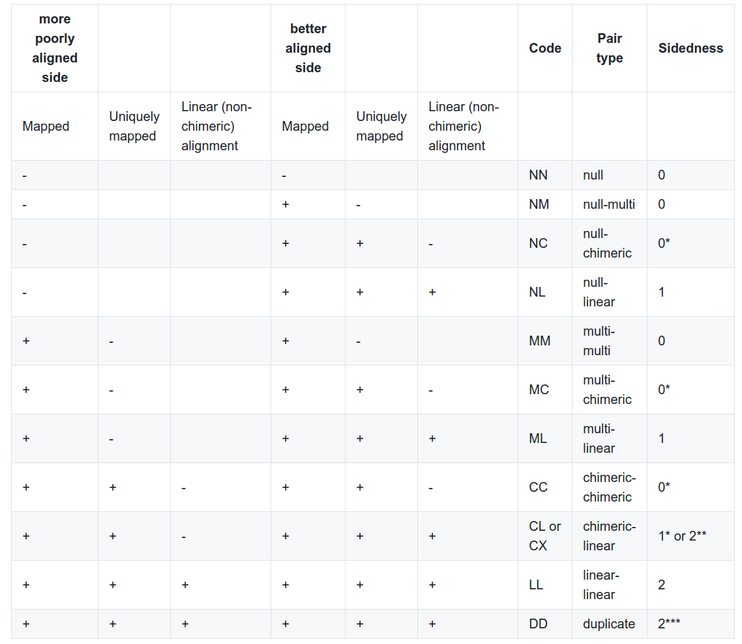
align
classify
sort + dedup
filter + bin
balance
Unambiguous pairs:
LL + CX

Slide 36
Chromosome order matters!
chr1
chr2
chr3
chr4
chr5
…
align
In contact lists, contact records should reflect a given chromosome order so that contacts lie exclusively in the upper triangle of the map tiled using that chromosome order.
classify
sort + dedup
filter + bin
chrom1, pos1, chrom2, pos2, …
balance

Slide 37
align
remove PCR duplicates by finding pairs of entries with both sides mapped to similar genomic locations (+/- N bp)
optionally output the PCR duplicate entries into a separate file for QC
classify
sort + dedup
filter + bin
balance

Slide 38
Genomic proximity and informative ligation products
align
classify
sort + dedup
filter + bin
balance

Slide 39
Genomic proximity and informative ligation products
align
Enriched in dangling ends
classify
Enriched in self circles
sort + dedup
filter + bin
balance

Slide 40
Proximity filtering
Filter pairs within fragments
Remove/ignore diagonals
Bin quality filtering
Bins with poor coverage
Cutoff on row sum, nnz
Truncate the tails of the row sum distribution (MAD-max)
Other artifacts
SVs, translocations
Can be done before or after binning
align
classify
sort + dedup
filter + bin
balance

Slide 41
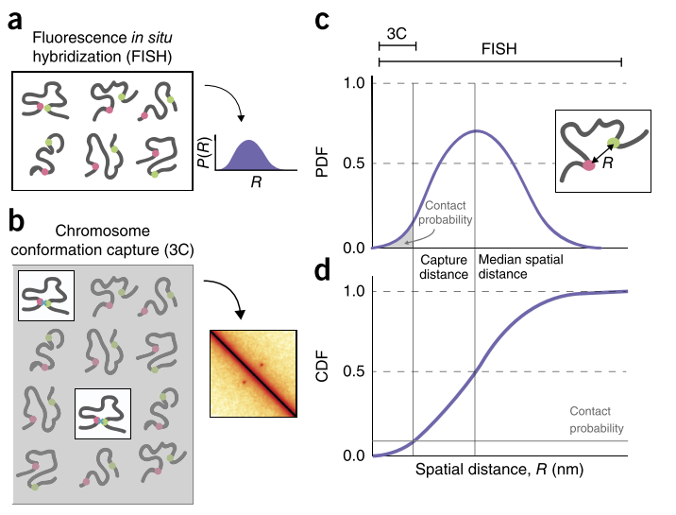
FISH or C?
FISH
In general: Single cell
Spatial distance
Any distance outside probe “glare”
Chromosome Conformation Capture
In general: population
Contact frequency
Capture radius dependent
Long distances in close proximity
Finn, BioRxiv, 2017
Belmont, Curr.Opin.Cell Biol. 2014
Giorgietti, Gen.Biol 2016
Fudenberg and Imakaev, Nat.Methods 2017
Notes:
Elizabeth Finn Started a nice discussion on this at 4DN on Monday

Slide 42


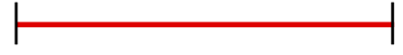
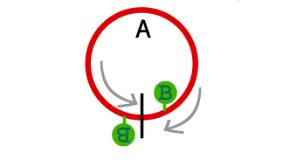
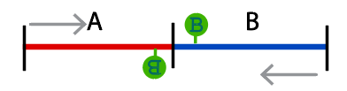
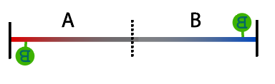




Interactions and product pairs
Digestion products
A
B
A
B
A
Ligation products
Valid pairs
Partial digests
Self circles
Dangling ends
Mapping products
error
pairs

Slide 43
Territoriality
Chr.6
Chr.7
Chr.8
cis
trans
Chr.6
Chr.7
Chr.8
Cremer & Cremer, Nature Review Genetics (2001)

Slide 44

From structures to organizing processes

